Slide 1
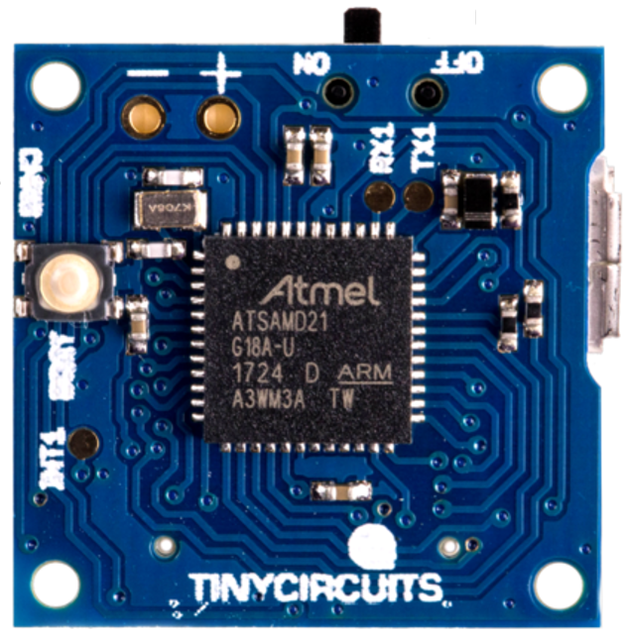
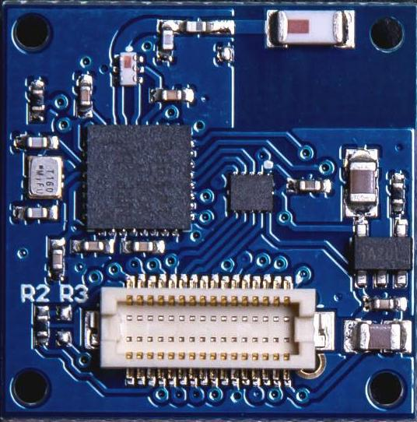
CSE190 Winter 2020
Lecture 2
MCUs and IO
Wireless Embedded Systems
Aaron Schulman

Slide 2
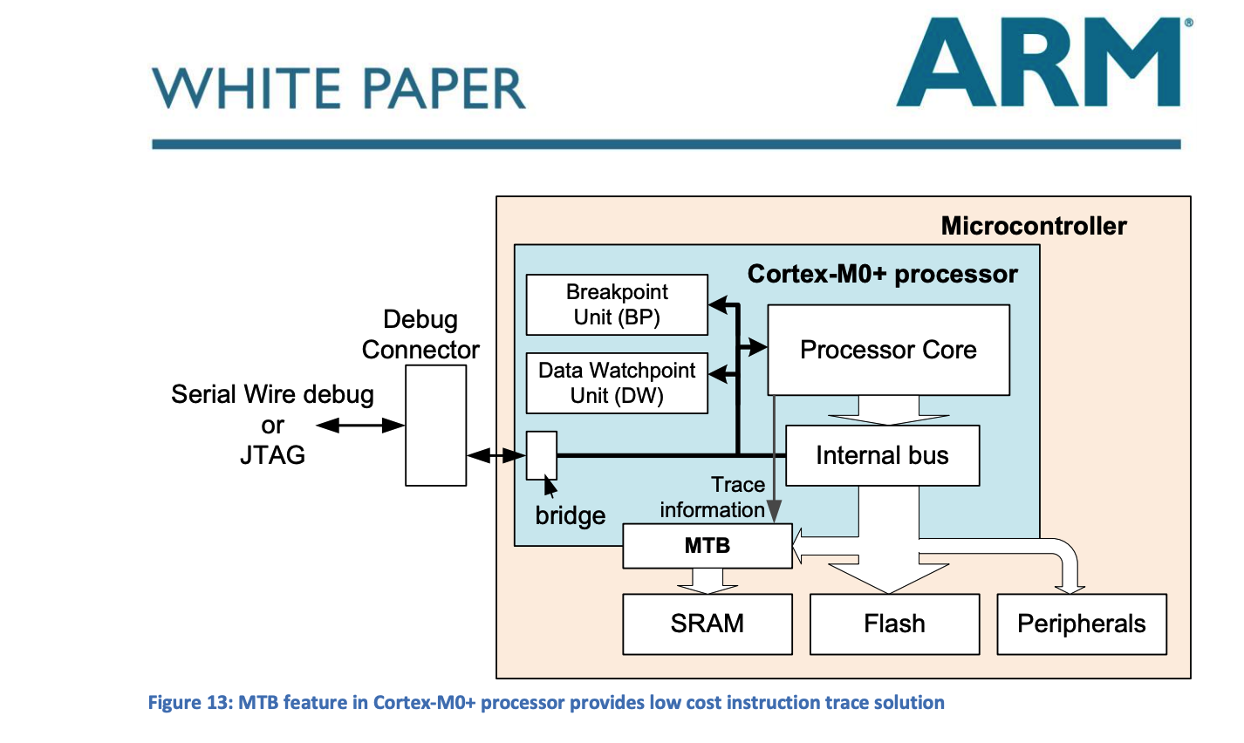
Reading for next week
Posted on Website – Please skim.
“ARM Cortex-M for Beginners”

Slide 3
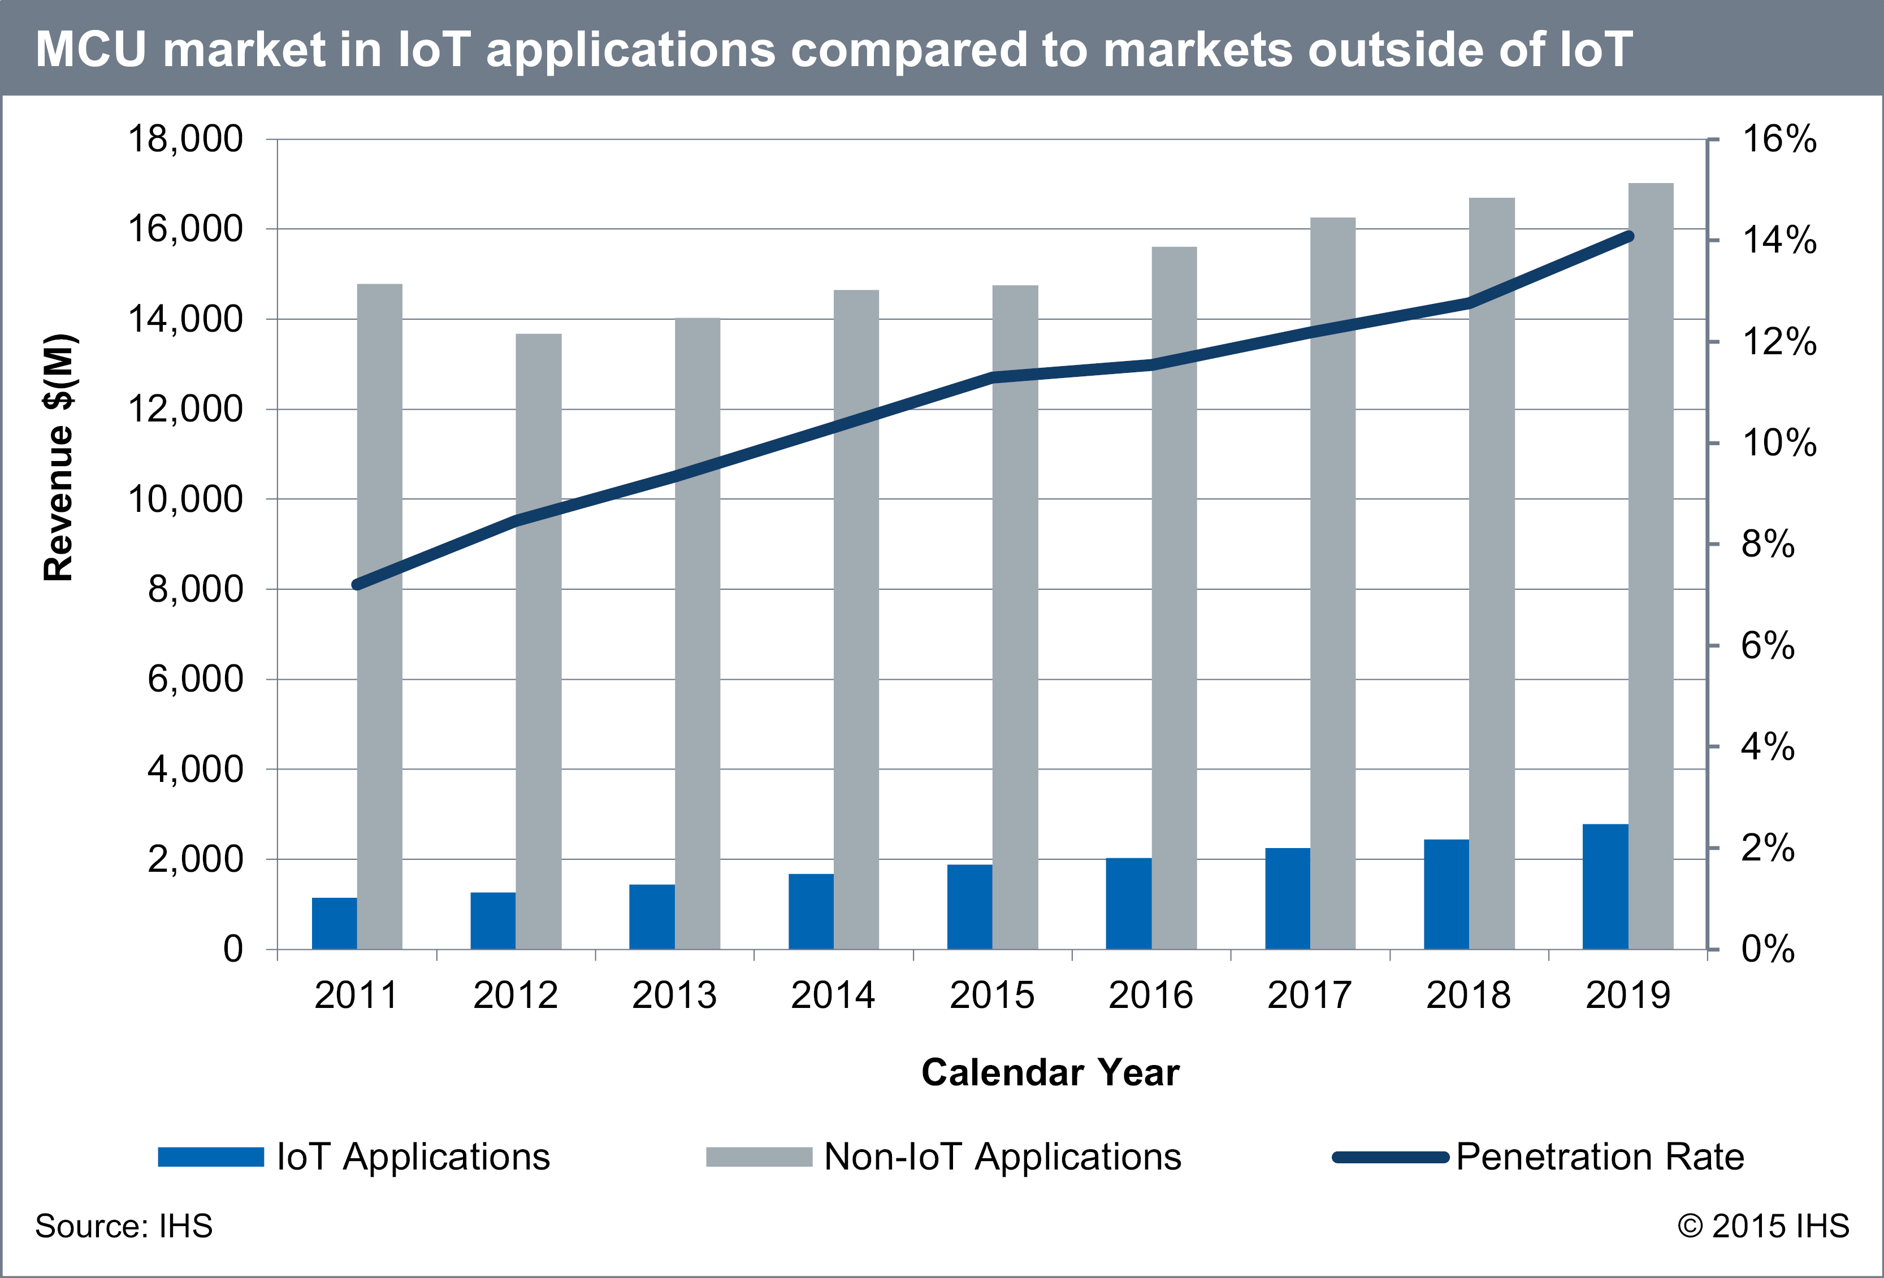
Introduction to Microcontrollers

Slide 4
Introduction to Microcontrollers
A microcontroller (MCU) is a small computer on a single integrated circuit consisting of a relatively simple central processing unit (CPU) combined with peripheral devices such as memories, I/O devices, and timers.
By some accounts, more than half of all CPUs sold worldwide are microcontrollers

Slide 5
Die shot of a microcontroller

Slide 6
Microcontroller VS Microprocessor
A microcontroller is a small computer on a single integrated circuit containing a processor core, memory, and programmable input/output peripherals.
A microprocessor incorporates the functions of a computer’s central processing unit (CPU) on a single integrated circuit.

Slide 7
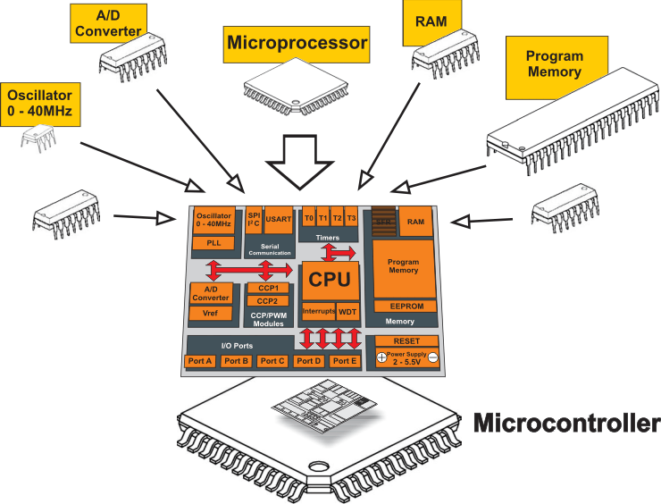
Microcontroller VS Microprocessor

Slide 8
Types of Processors
In general-purpose computing, the variety of instruction set architectures today is limited, with the Intel x86 architecture overwhelmingly dominating all.
There is no such dominance in embedded computing. On the contrary, the variety of processors can be daunting to a system designer.
Things that matter
Peripherals, Concurrency & Timing, Clock Rates, Memory sizes (SRAM & flash), Package sizes

Slide 9
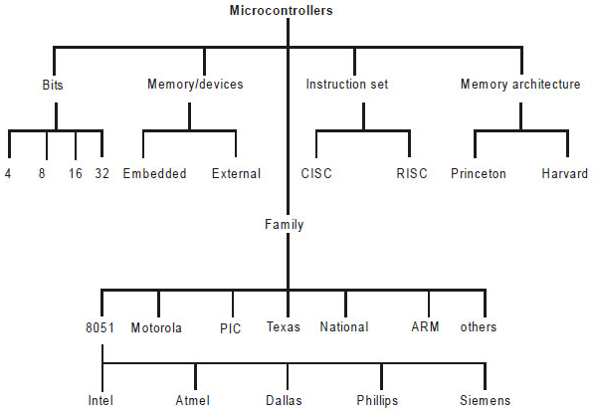
Types of Microcontrollers

Slide 10
How to choose MCU for our project?
What metrics we need to consider?
Power consumption
Clock frequency
IO pins
Memory
Internal functions
Others

Slide 11
How to choose MCU for our project?
What metrics we need to consider?
Power consumption
We cannot afford mA MCU because the power budget of the system is 3.47mA.
Clock frequency (speed that instructions are executed)
kHz is too slow…
100MHz is over kill...
IO pins
Lots of peripherals - Image sensor, UART debugger, SD card, DAC, ADC, microphone, LED

Slide 12
How to choose MCU for our project?
What metrics we need to consider?
Memory
We need to have sufficient memory to store:
Program (Non-volatile): Logic to read from sensors, communicate
Stack: Function calls are now expensive (no recursion)
Data: Constants (time periods), Sensor history, Communication state
Internal functions
Migrating data from the sensor to the radio (DMA)

Slide 13
How to choose MCU for our project?
Memory
Store accelerometer history data
12bits each for X,Y,Z acceleration
sampled 2 thousand times a second (2 KHz)
= 12*3*2,000 bits per second (72kbits or 9 kBytes)
How many seconds can we hold if we have only 100 kBytes of storage
What types of memory are available on an MCU?
Internal memory: RAM, 0.5~128 kBytes
External memory: Flash, high power consumption, ~5mA for read and ~10mA for erase

Slide 14
How to choose MCU for our project?
Clock frequency
kHz is too slow
Smartphone camera frame rate is 60fps (1 KHz clock would leave only 60 clock cycles per frame)
100MHz is too fast
Power consumption is high
Several MHz would be ideal

Slide 15
How to choose MCU for our project?
IO pins (interface for external peripherals)
Interfacing sensors, UART debugger, LEDs, Bluetooth
We need a large number of IO pins
We need various types of IO pins
Analog pins (input/output analog signals e.g., audio)
Digital pins (input/output digital signals e.g., busses, GPIOs)

Slide 16
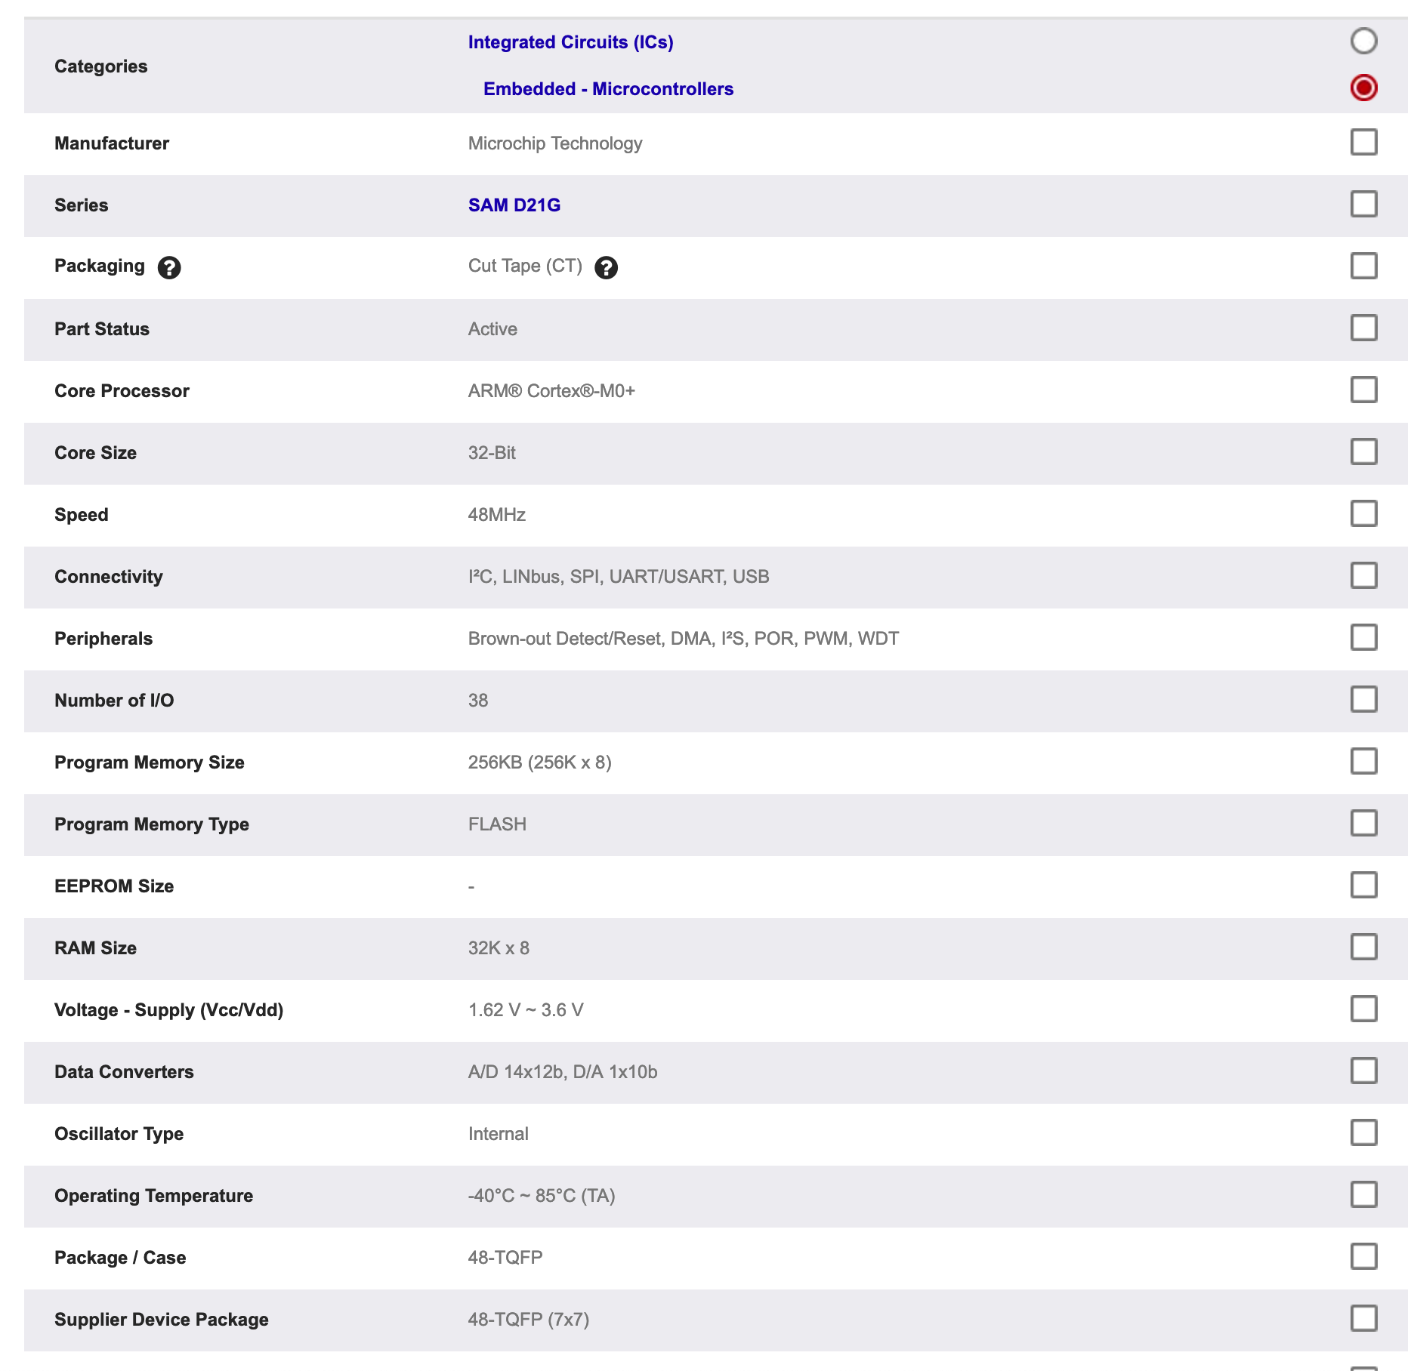
The MCU used in our projects

Slide 17
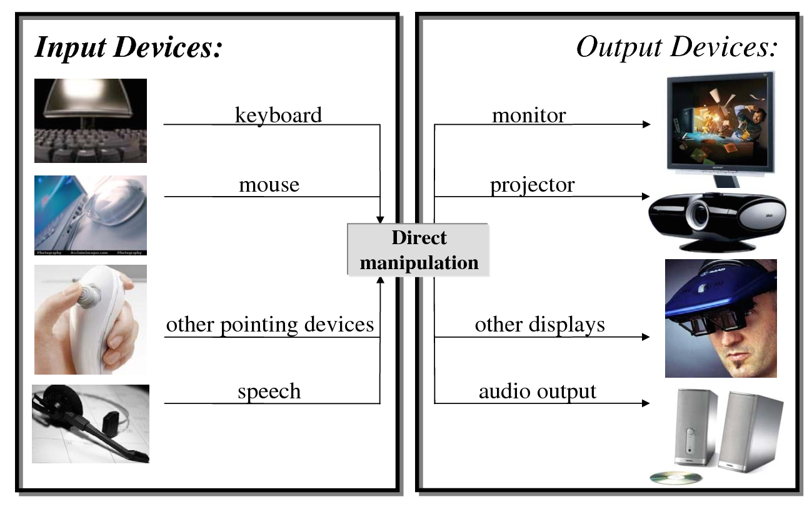
Input and Output (I/O)

Slide 18
I/O Devices (sensors)
Keyboard, mouse, microphone, scanner, video/photo camera, etc.
Large diversity
Many widely differing device types
Devices within each type also differs
Speed
varying, often slow access & transfer compared to CPU
Some device-types require very fast access & transfer
Access
Sequential VS random
read, write, read & write

Slide 19
What operations does software need to perform on peripherals?
Get and set parameters
Receive and transmit data
Enable and disable functions

Slide 20
How can we imagine providing an interface to hardware from software?
Specialized CPU instructions (x86 in/out)

Slide 21
Port I/O
Devices registers mapped onto “ports”; a separate address space
Use special I/O instructions to read/write ports
Protected by making I/O instructions available only in kernel/supervisor mode
Used for example by IBM 360 and successors

Slide 22
How can we imagine providing an interface to hardware from software?
Specialized CPU instructions (x86 in/out)
Treating devices like they are memory (MMIO)

Slide 23
Memory Mapped IO
Device registers mapped into regular address space
Use regular move (assignment) instructions to read/ write a device’s hardware “registers”
Use memory protection mechanism to protect device registers

Slide 24
MMIO is used for embedded systems
Why not Ports I/O?
special I/O instructions would be instruction set dependent (x86, ARM Thumb, MIPS)
Bad if there are many different instruction sets out there
Need special hardware to execute and protect instructions
Memory mapped I/O:
Can use all existing memory reference instructions for I/O
Can reuse code for reading and writing (e.g., memcpy)
Memory protection mechanism allows greater flexibility than protected instructions (protect specific registers)
Can reuse memory management / protection hardware to interface with hardware (saves space and power)

Slide 25
Reading and writing with MMIO is not like talking to RAM
MMIO reads and writes hardware device registers
Reads and write to registers can cause peripherals to begin or end an operation
By reading data, it may cause the hardware to do something!!!
E.g., Clear an interrupt flag, get the next byte on a bus
By writing data, it may cause the hardware to do something with it
E.g., Send this data over the UART bus

Slide 26
GPIOs are the general digital I/O device
Each GPIO pin represents one bit in memory: if the pin is on it’s a 1, off it’s a 0
That bit can be an input or an output
GPIOs can be used to control lights (light on or off), but even more
Indicating that an event just happened
Interrupt the radio to tell it to transmit data
Interrupt the CPU to tell it a button was pressed
Read pin status to receive configuration messages
Debugging
Did this one part of my code actually execute?
Is the timer firing at the interval that I expect it to fire (connect GPIO to oscilloscope)?
Why using GPIO?
GPIO ops are lightweight

Slide 27
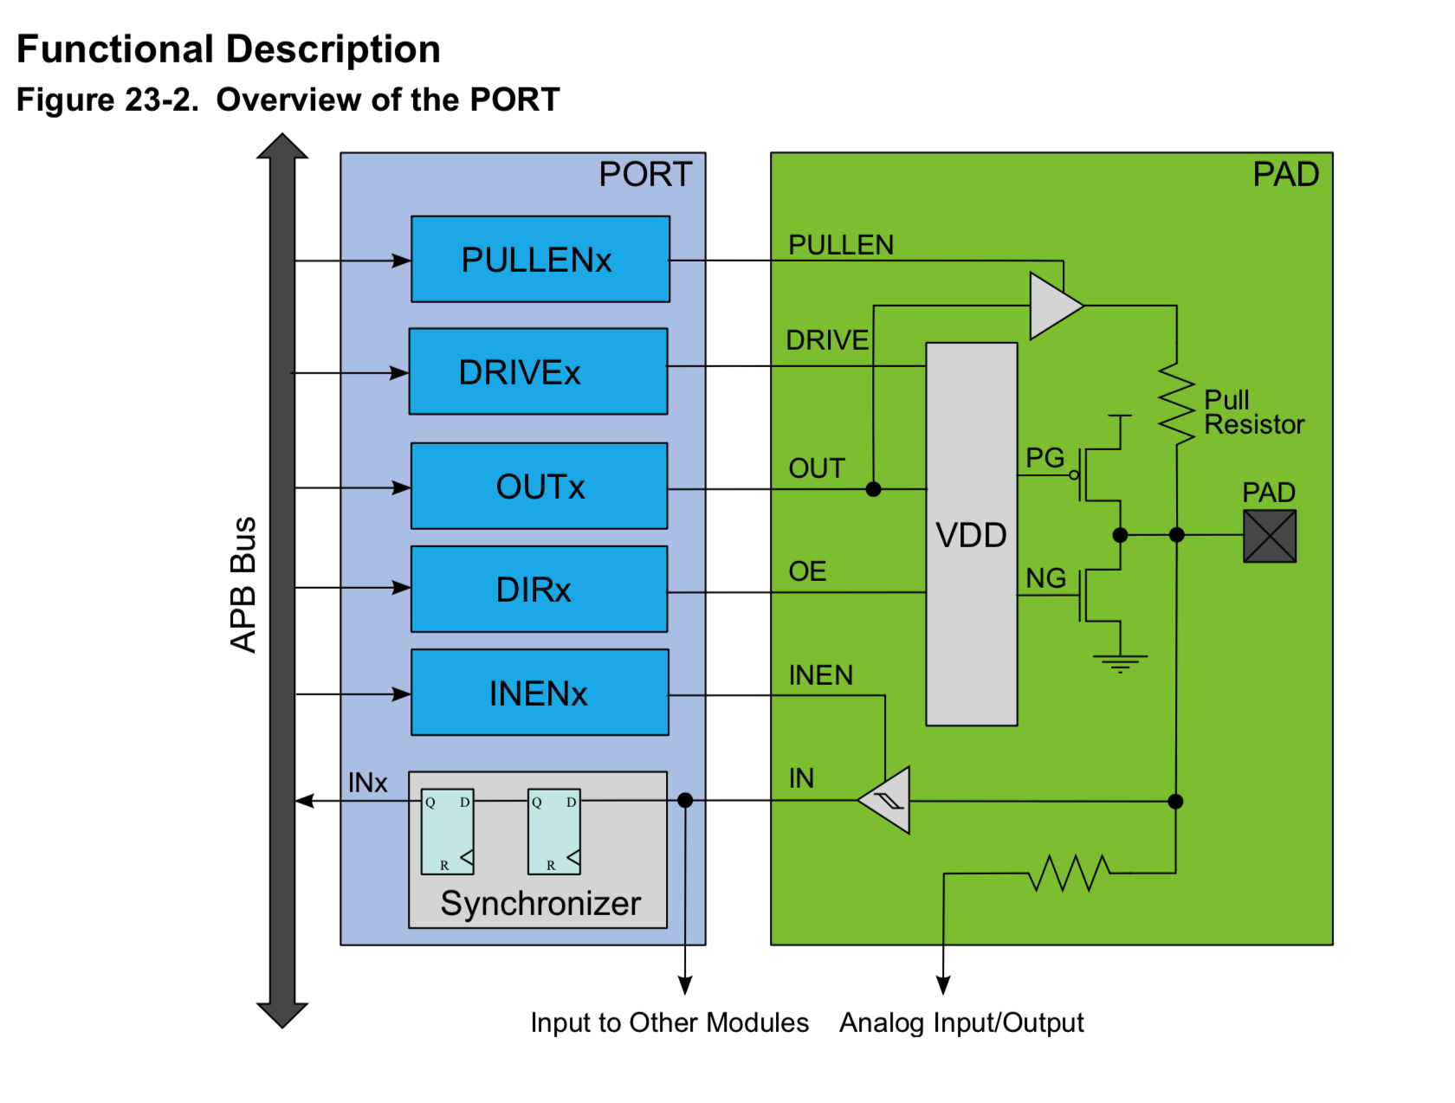
Topology of a GPIO pin

Slide 28
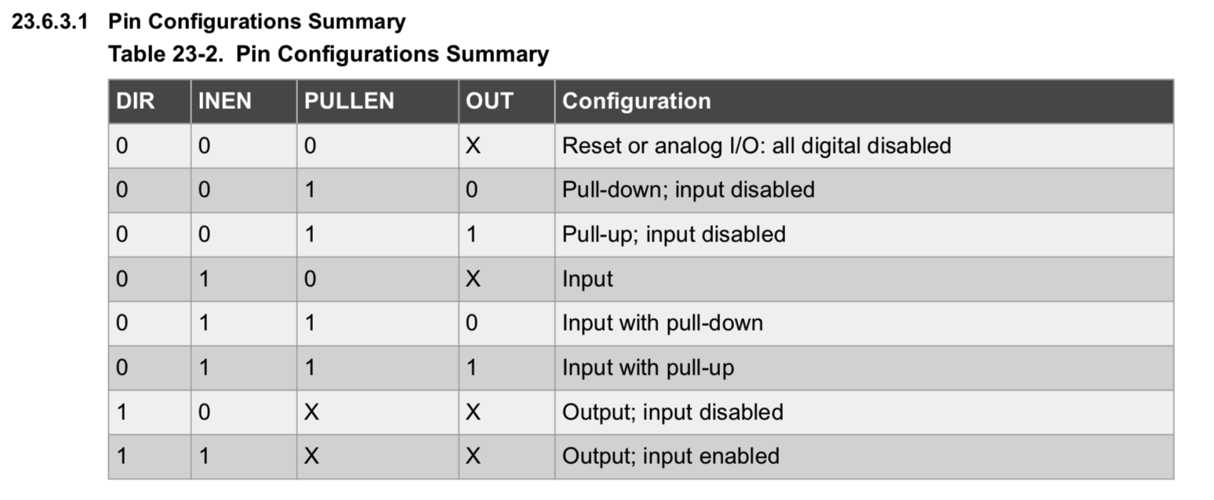
GPIO Configurations

Slide 29
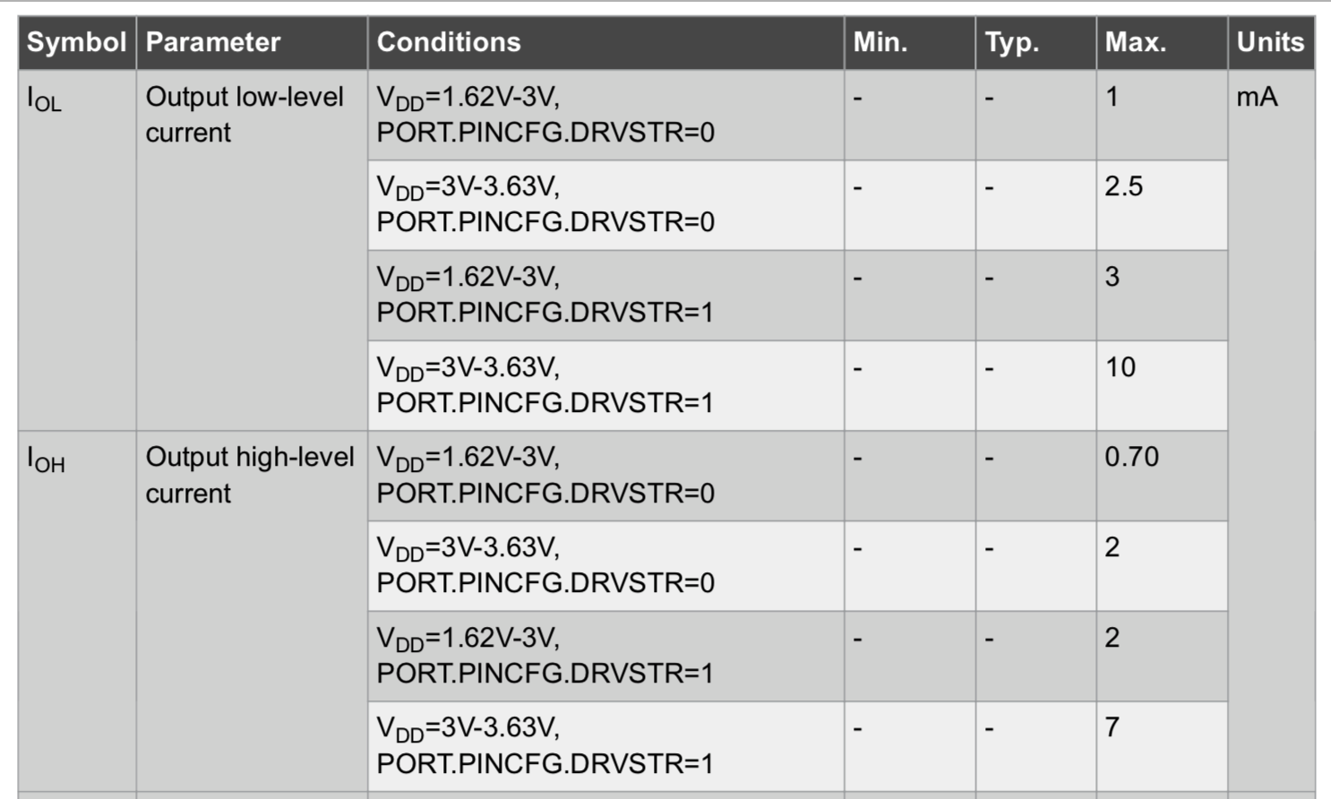
A fun extra feature: Drive Strength

